Slide 1



Hospitality Domain
Data Analysis Project using Python and pandas
Presented by: Bhavan vs

Slide 2



Agenda
Problem Statement
About the dataset
Data Cleaning
Data Transformation
Analysis Insights

Slide 3

Timeline
Problem statement
About the dataset
Data cleaning
Data transformation
Analysis Insights
Briefly elaborate on what you want
to discuss.
Briefly elaborate on what you want
to discuss.
Briefly elaborate on what you want
to discuss.
Briefly elaborate on what you want
to discuss.
Briefly elaborate on what you want
to discuss.

Slide 4



Problem Statement
AtliQ Grand owns multiple five-star hotels across India. They have been in the hospitality industry for past 20 years. Due to strategic moves from other competitors and ineffective decision-making in the management, AtliQ grands are losing its market share and revenue in the luxury/business hotels category.
As a strategic move, the managing director of AtliQ Grands wanted to regain their market share and revenue. Their revenue managerment team had decided to hire a 3rd party service provider to provide them with insights from their historical data.
You are a data analyst who has been provided with sample data to provide the revenue insights to the team

Slide 5
Timeline
Problem statement
About the dataset
Data cleaning
Data transformation
Analysis Insights
Briefly elaborate on what you want
to discuss.
Briefly elaborate on what you want
to discuss.
Briefly elaborate on what you want
to discuss.
Briefly elaborate on what you want
to discuss.
Briefly elaborate on what you want
to discuss.

Slide 6



About the dataset
Team provided the 3 months bookings data of AtliQ Grand having around 1.4 lakh records.
Dataset contains 3 dimension tables and 2 fact tables.
In between project, we were also provided with the August month data to include it in the previous data
dim_date.csv
dim_hotels.csv
dim_rooms.csv
fact_aggregated_bookings.csv
fact_bookings.csv

Slide 7

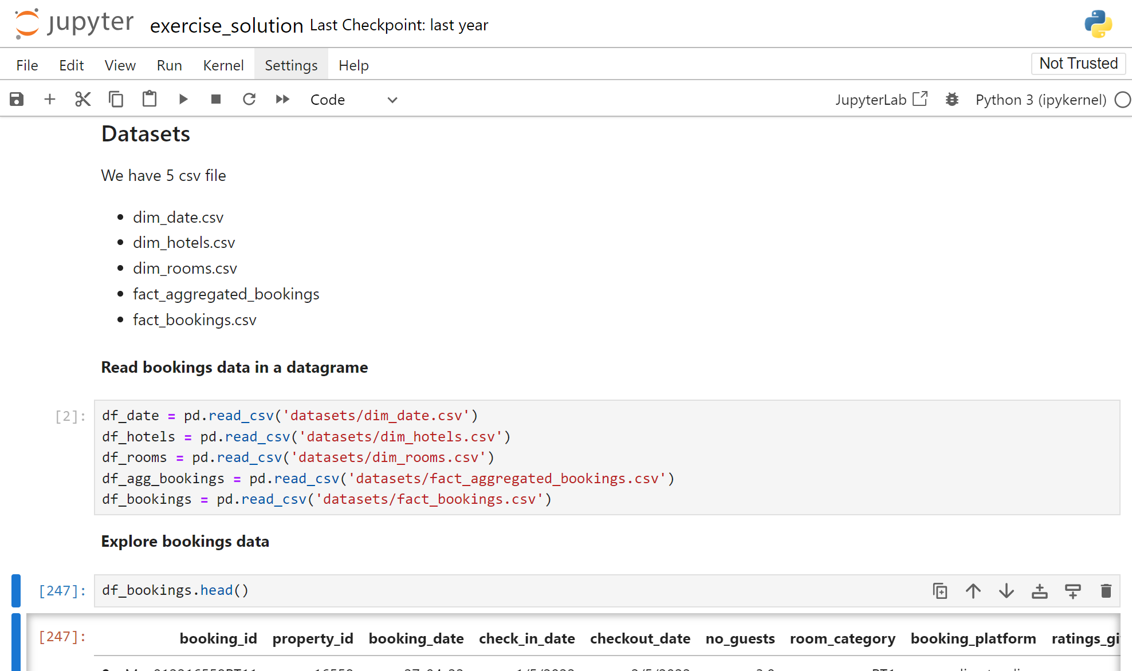
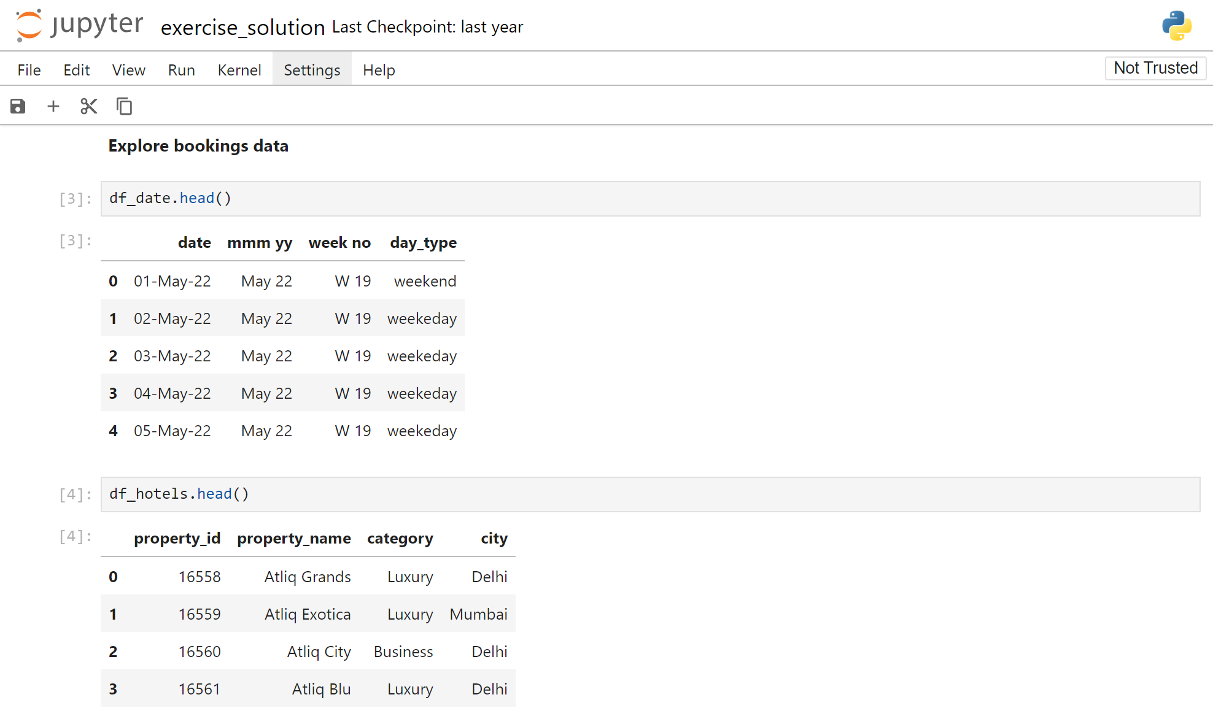
About the Datasets
Reading all the data in a dataframe
(1) Exploring dim_date data

Slide 8
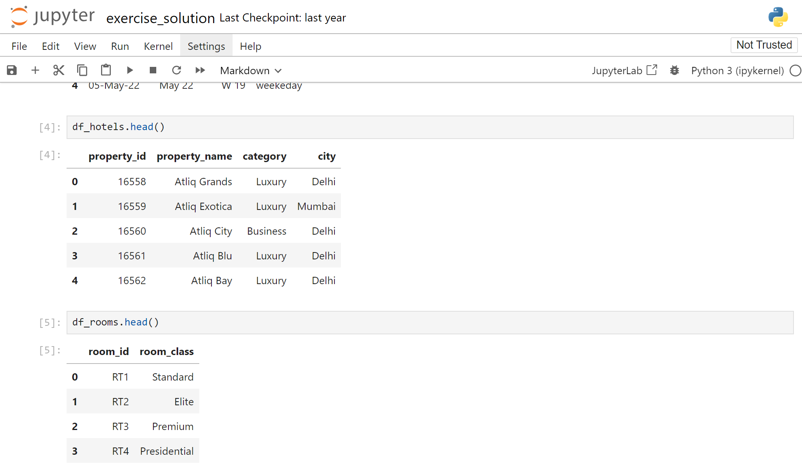
(2) Exploring dim_hotels data
(3) Exploring dim_rooms data

Slide 9
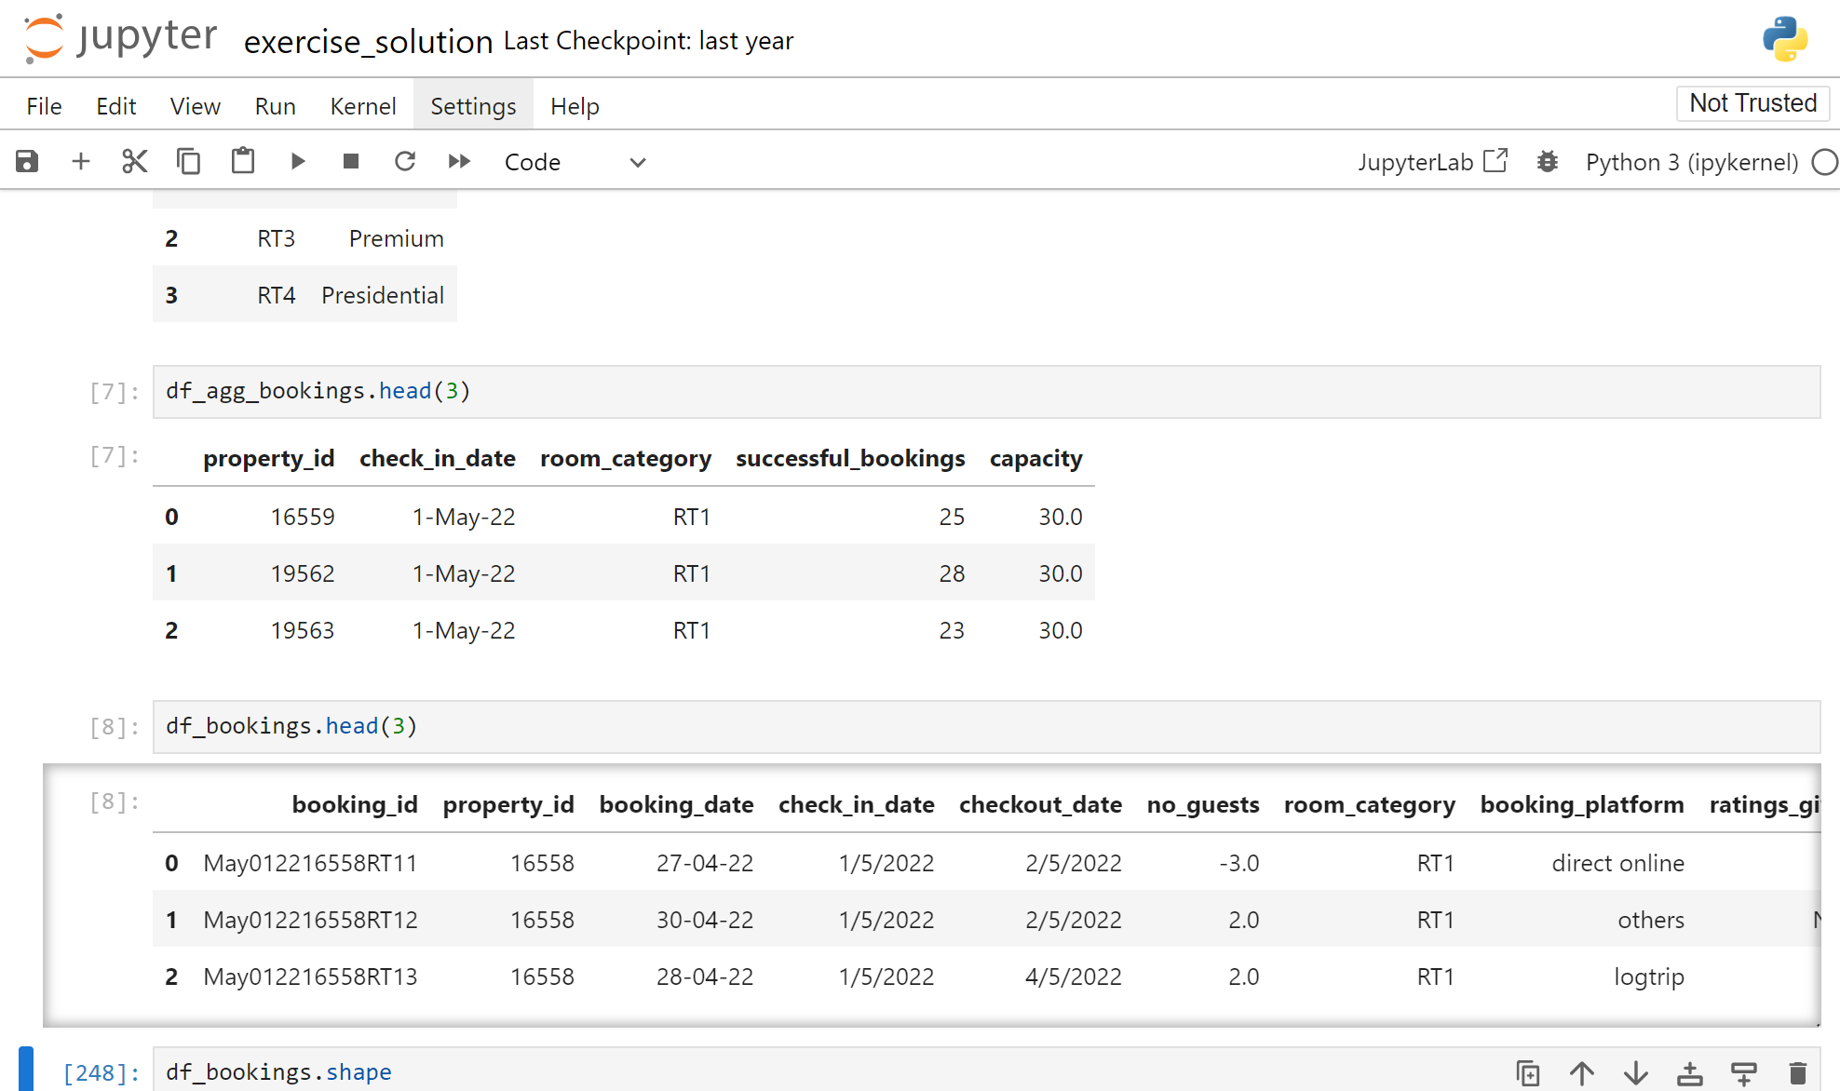
(4) Exploring df_agg_bookings data
(5) Exploring df_bookings data

Slide 10
Timeline
Problem statement
About the dataset
Data cleaning
Data transformation
Analysis Insights
Briefly elaborate on what you want
to discuss.
Briefly elaborate on what you want
to discuss.
Briefly elaborate on what you want
to discuss.
Briefly elaborate on what you want
to discuss.
Briefly elaborate on what you want
to discuss.

Slide 11
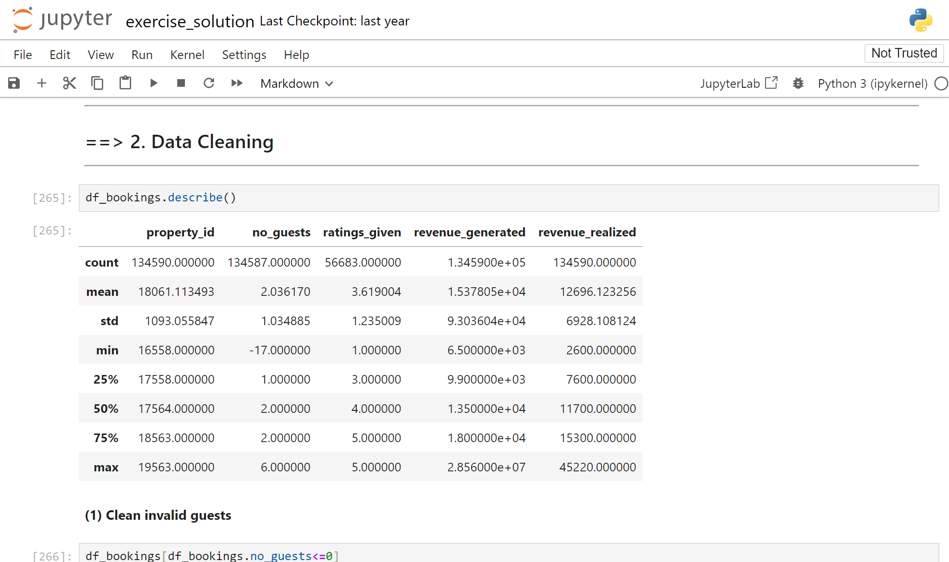
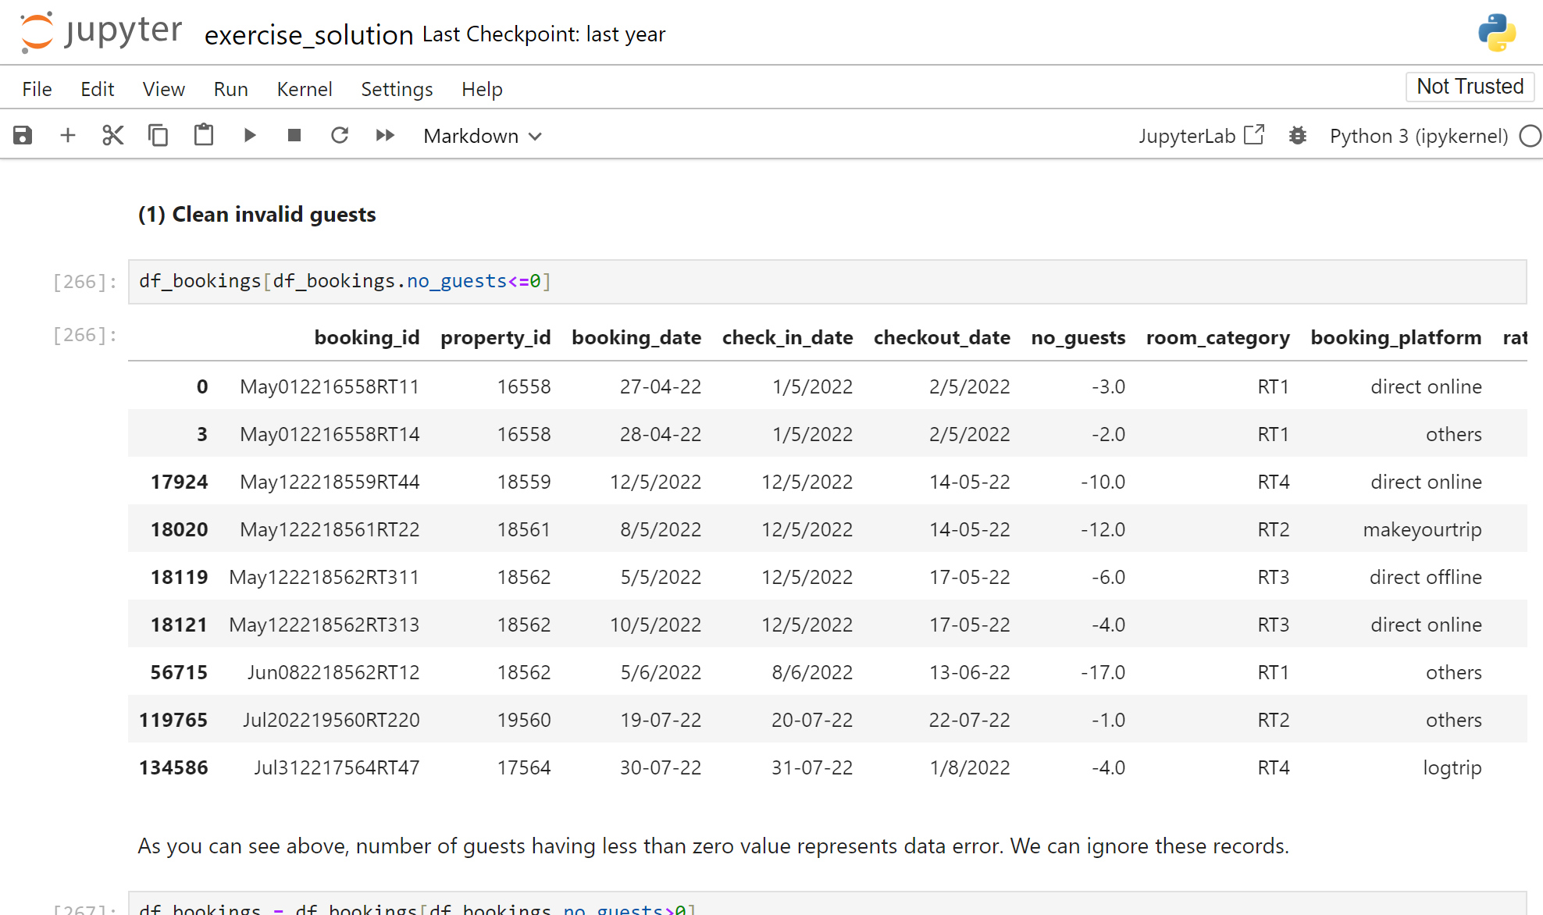
Data Cleaning
(1) Clean invalid guest
If we look closely we find that minimum number of guests is negative, which can’t be true
As you can see above, number of guests having less than zero value represents data error. We can ignore these records.

Slide 12
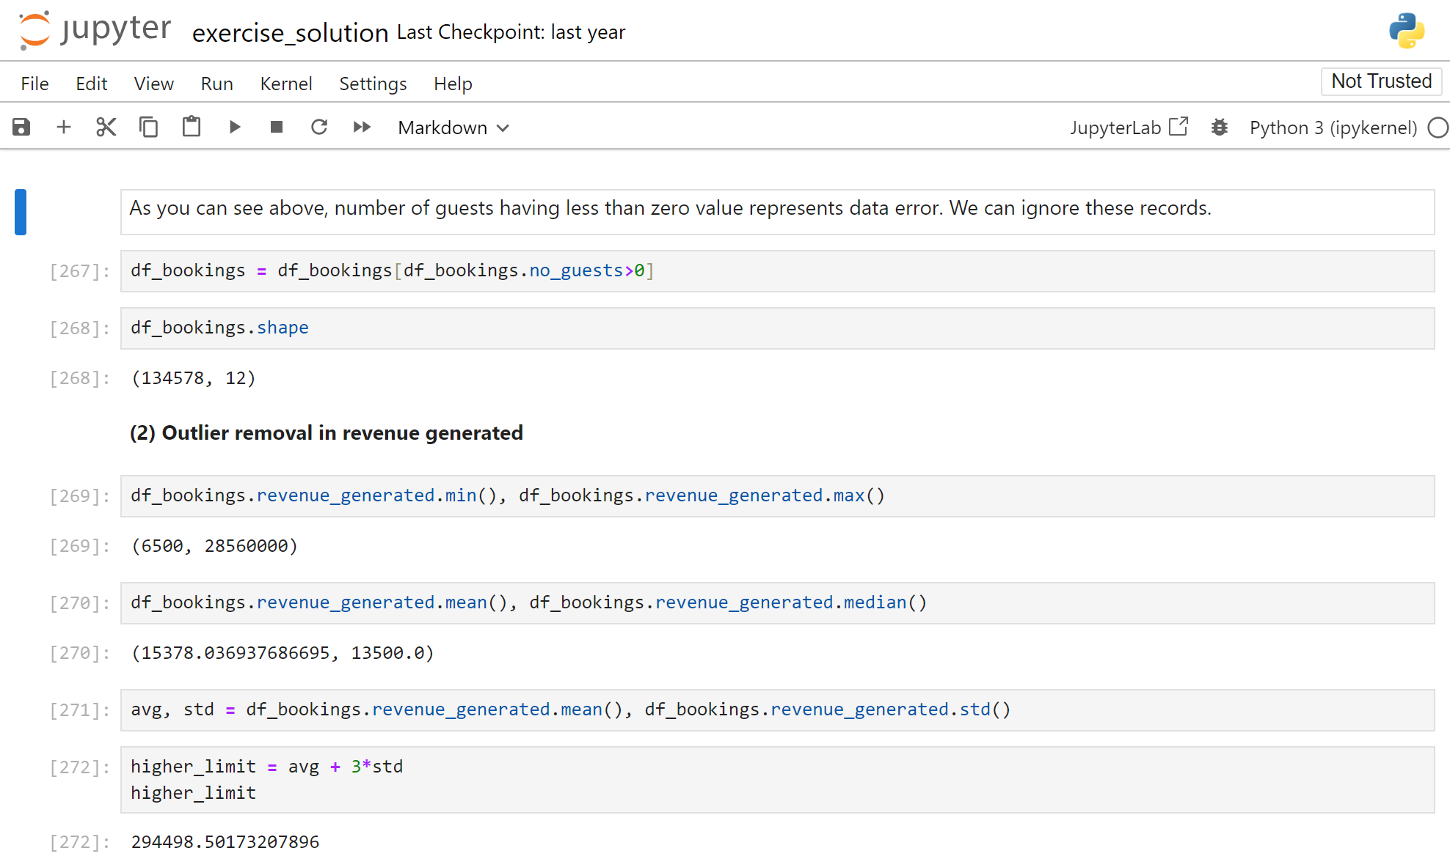
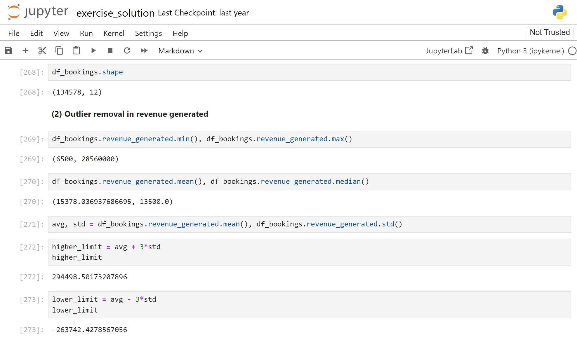
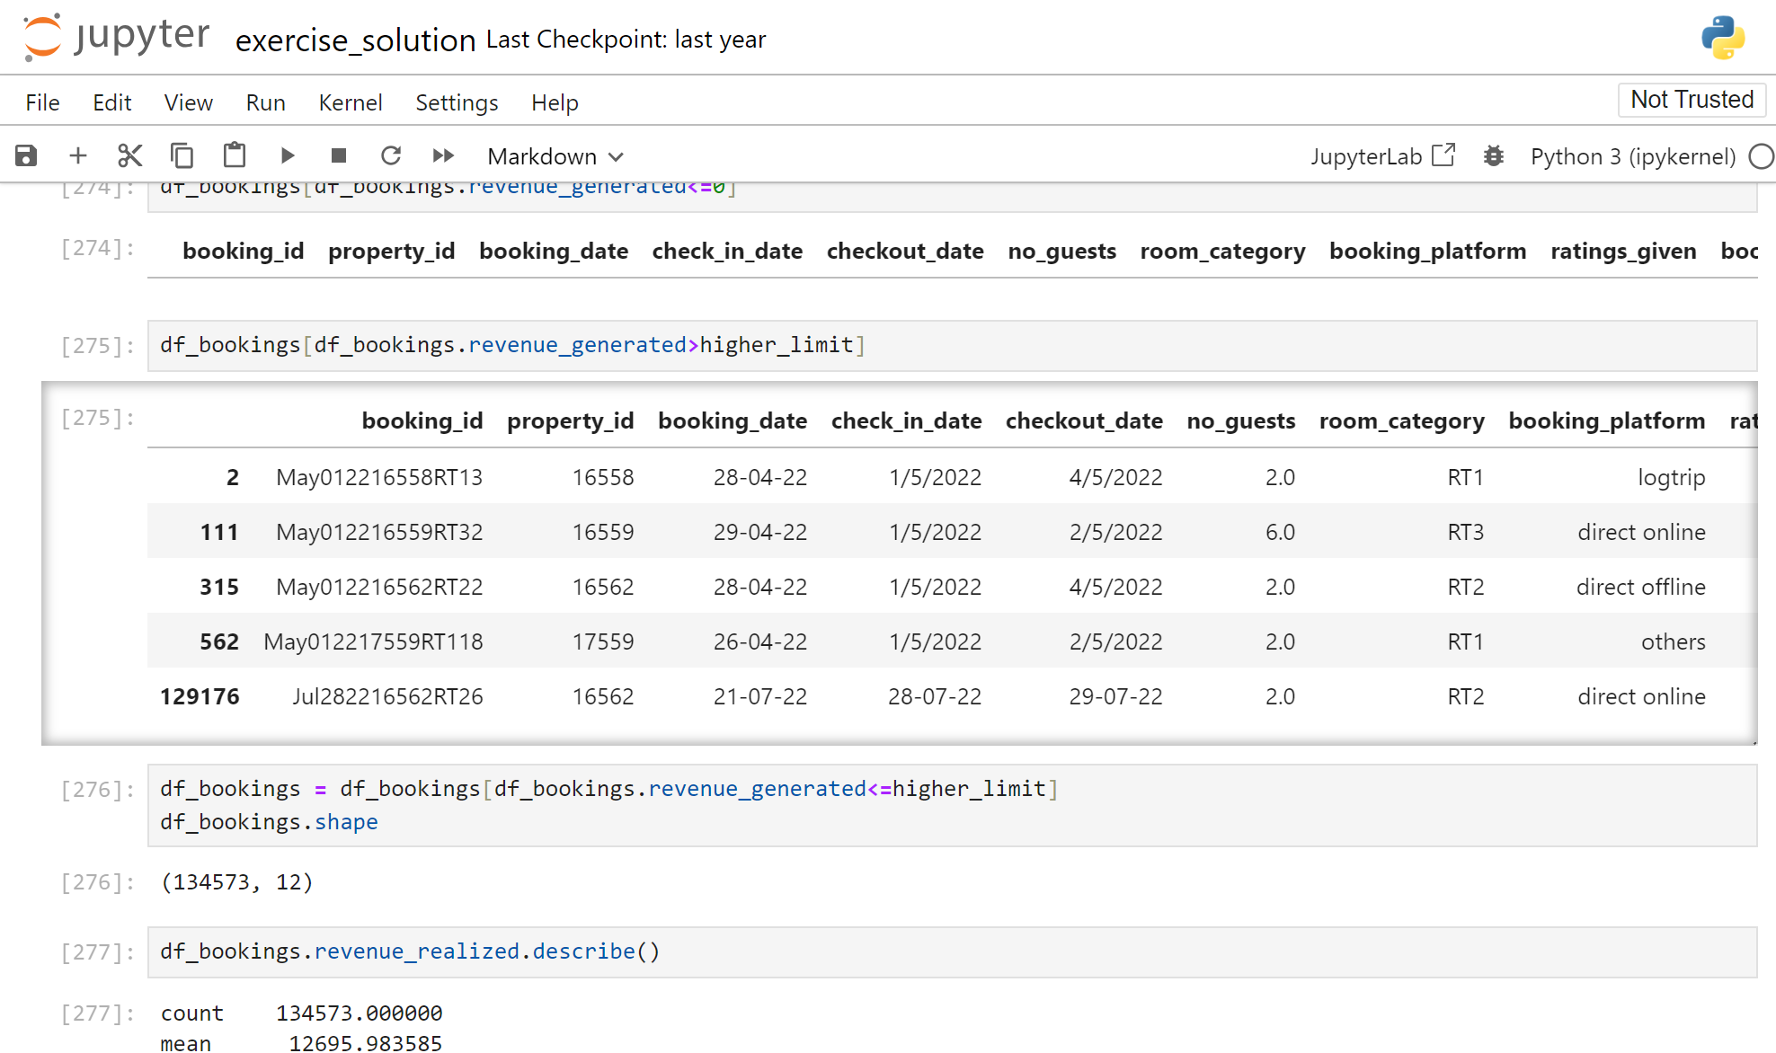
(2) Outlier removal in revenue generated
We have no negative values in rev_generated column

Slide 13
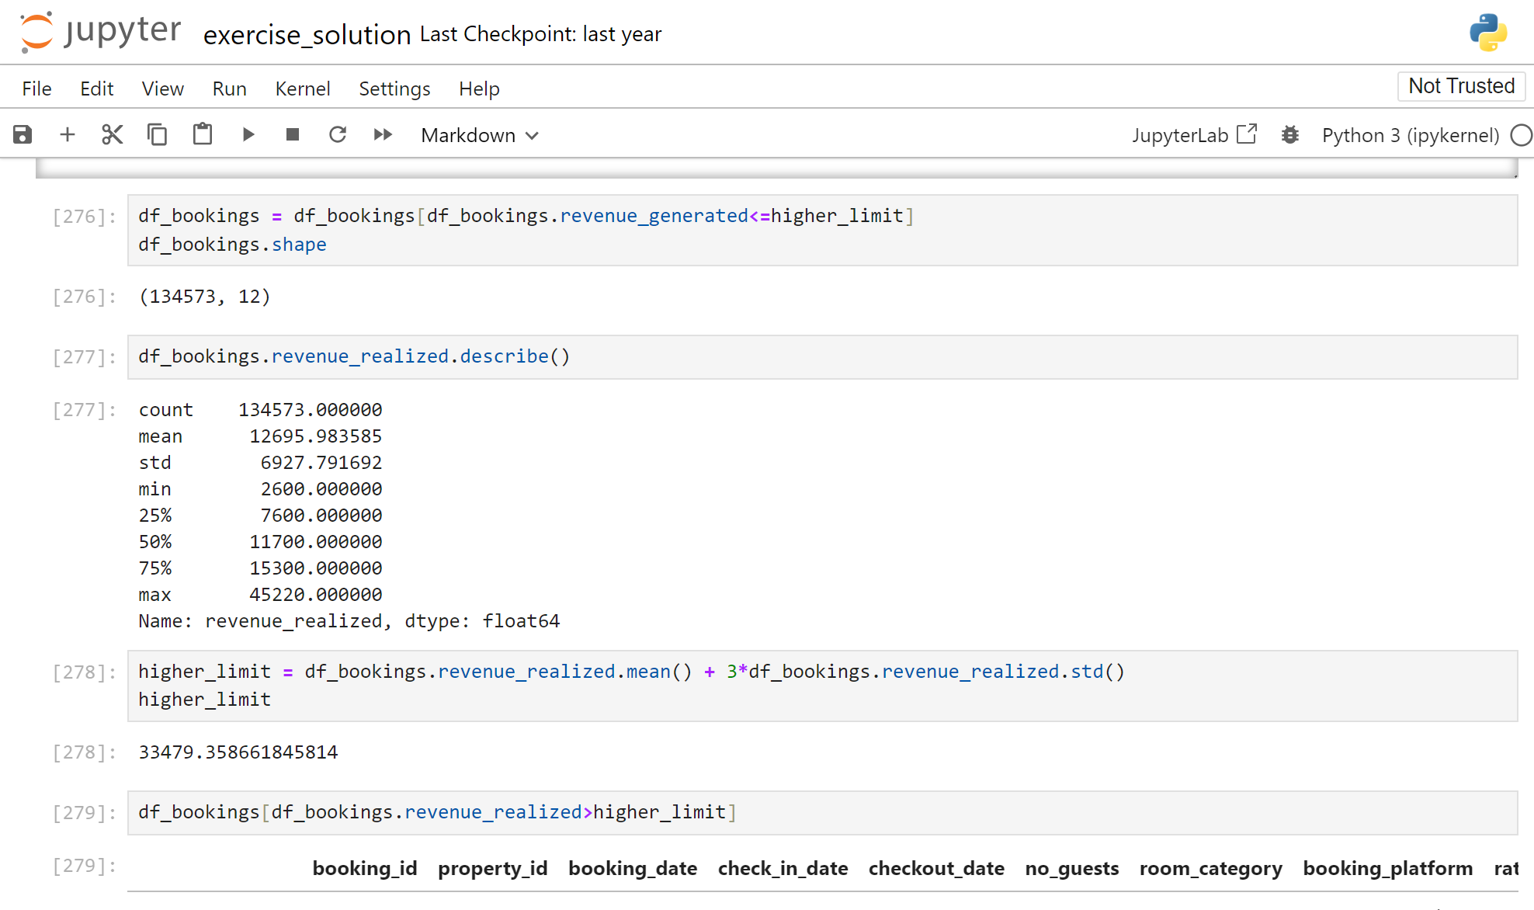
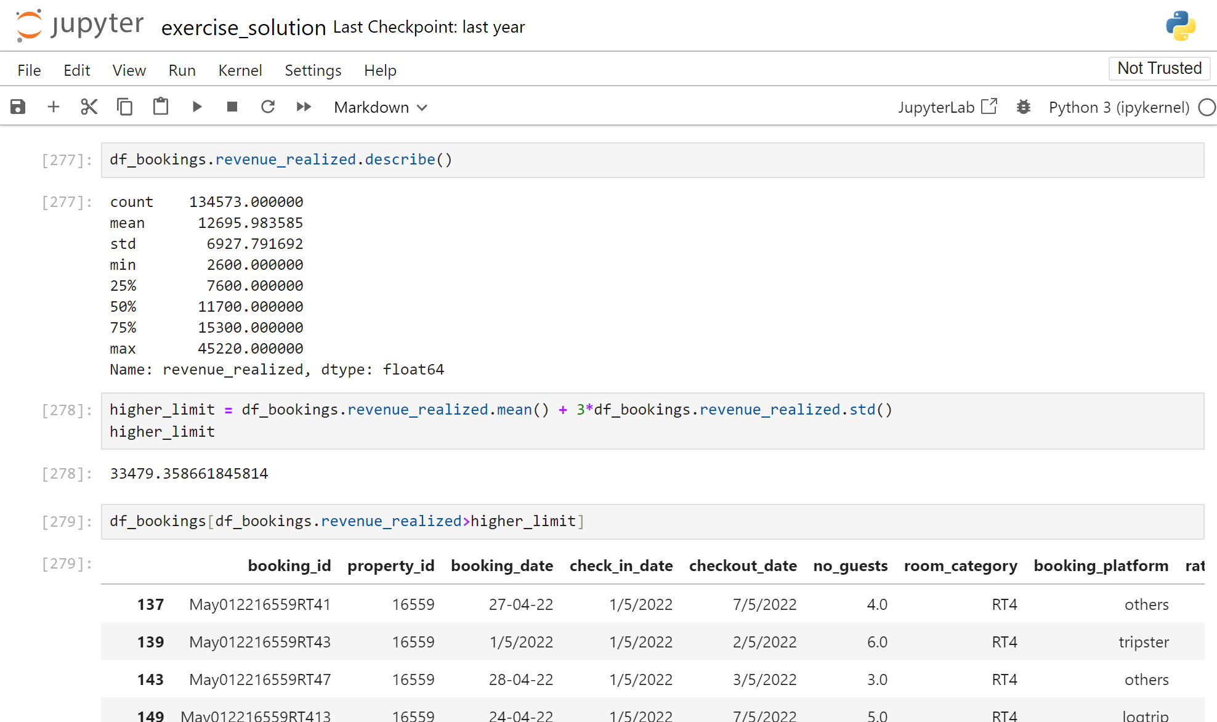
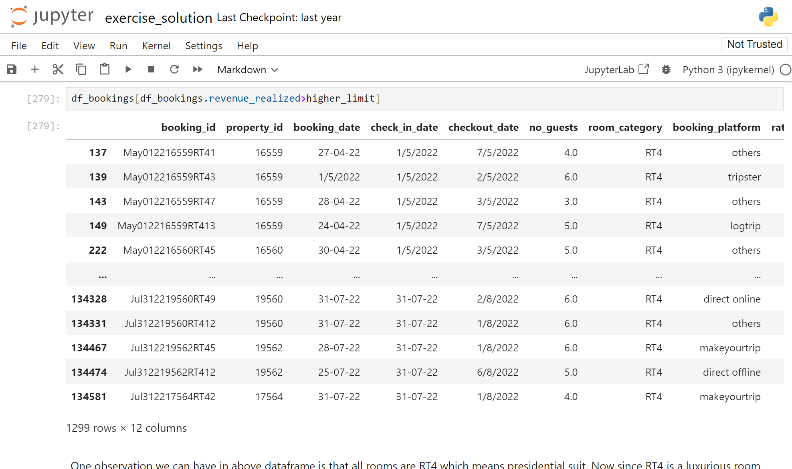
Since we have only 5 outliers, we can ignore them like we did earlier
(3) Outlier removal in revenue_realized
One observation we can have in above dataframe is that all rooms are RT4 which means presidential suit. Now since RT4 is a luxurious room it is likely their rent will be higher. To make a fair analysis, we need to do data analysis only on RT4 room types

Slide 14
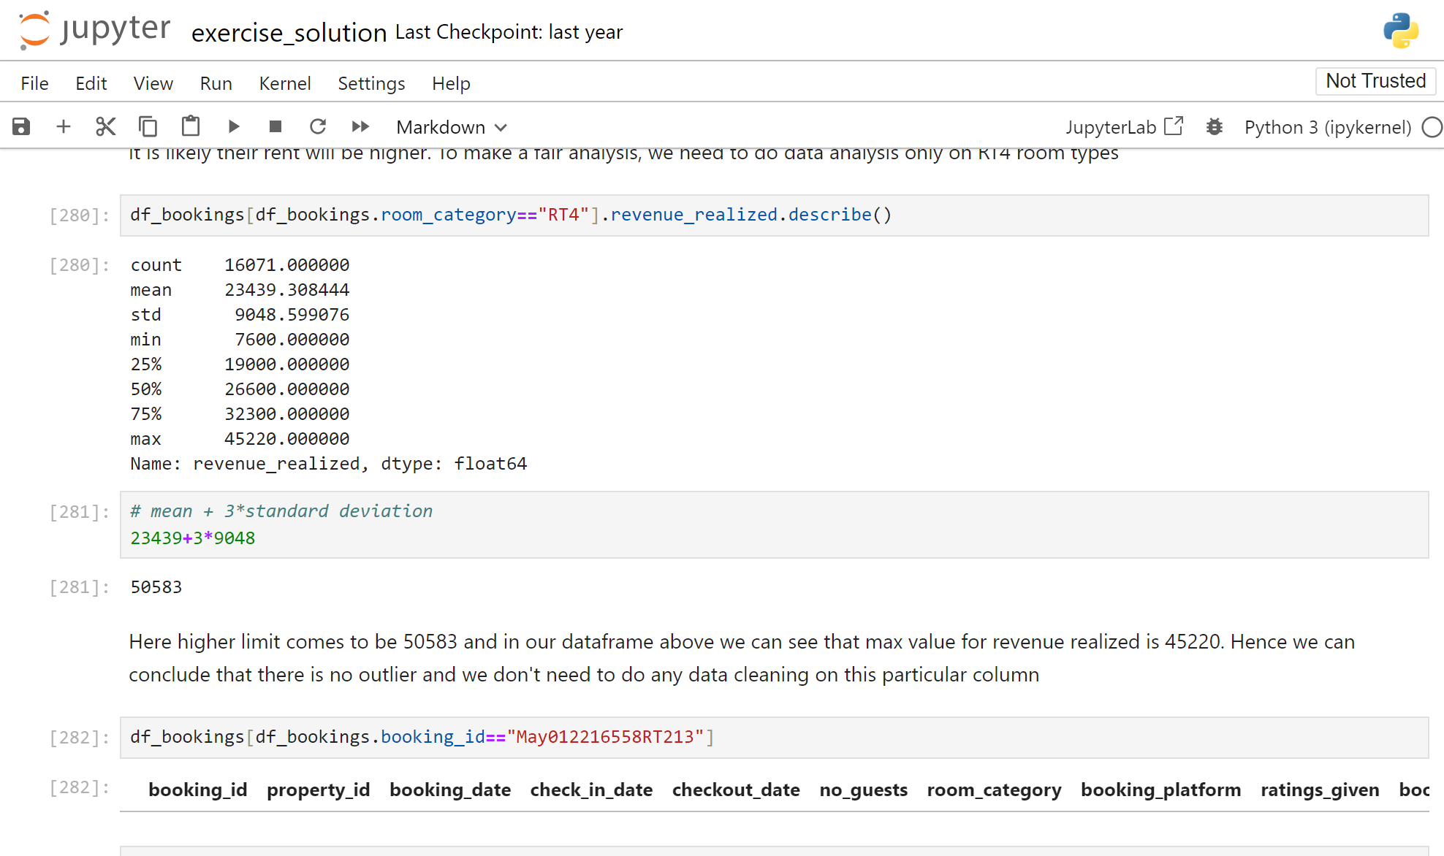
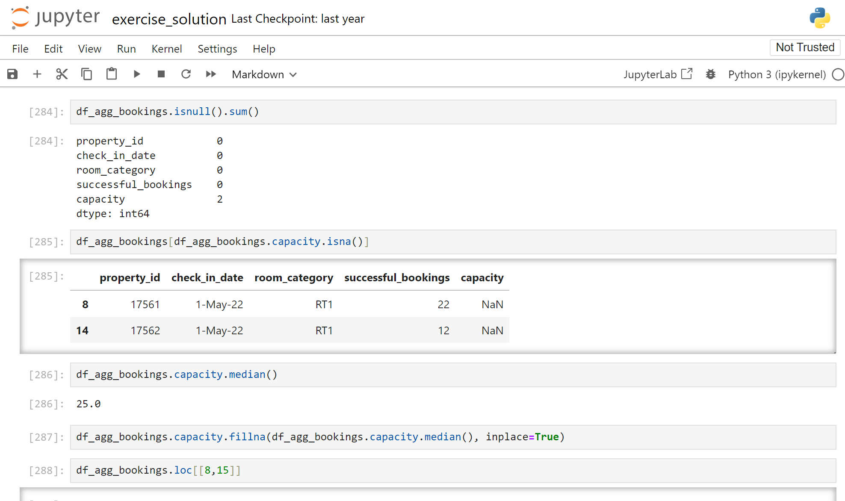
Here higher limit comes to be 50583 and in our dataframe above we can see that max value for revenue realized is 45220. Hence we can conclude that there is no outlier and we don't need to do any data cleaning on this particular column
(4) Null values in ratings_given column
Since, It is logical that every customer don’t provide rating, our ratings_given column can have null values.
(5) Null values in df_agg_booking column

Slide 15
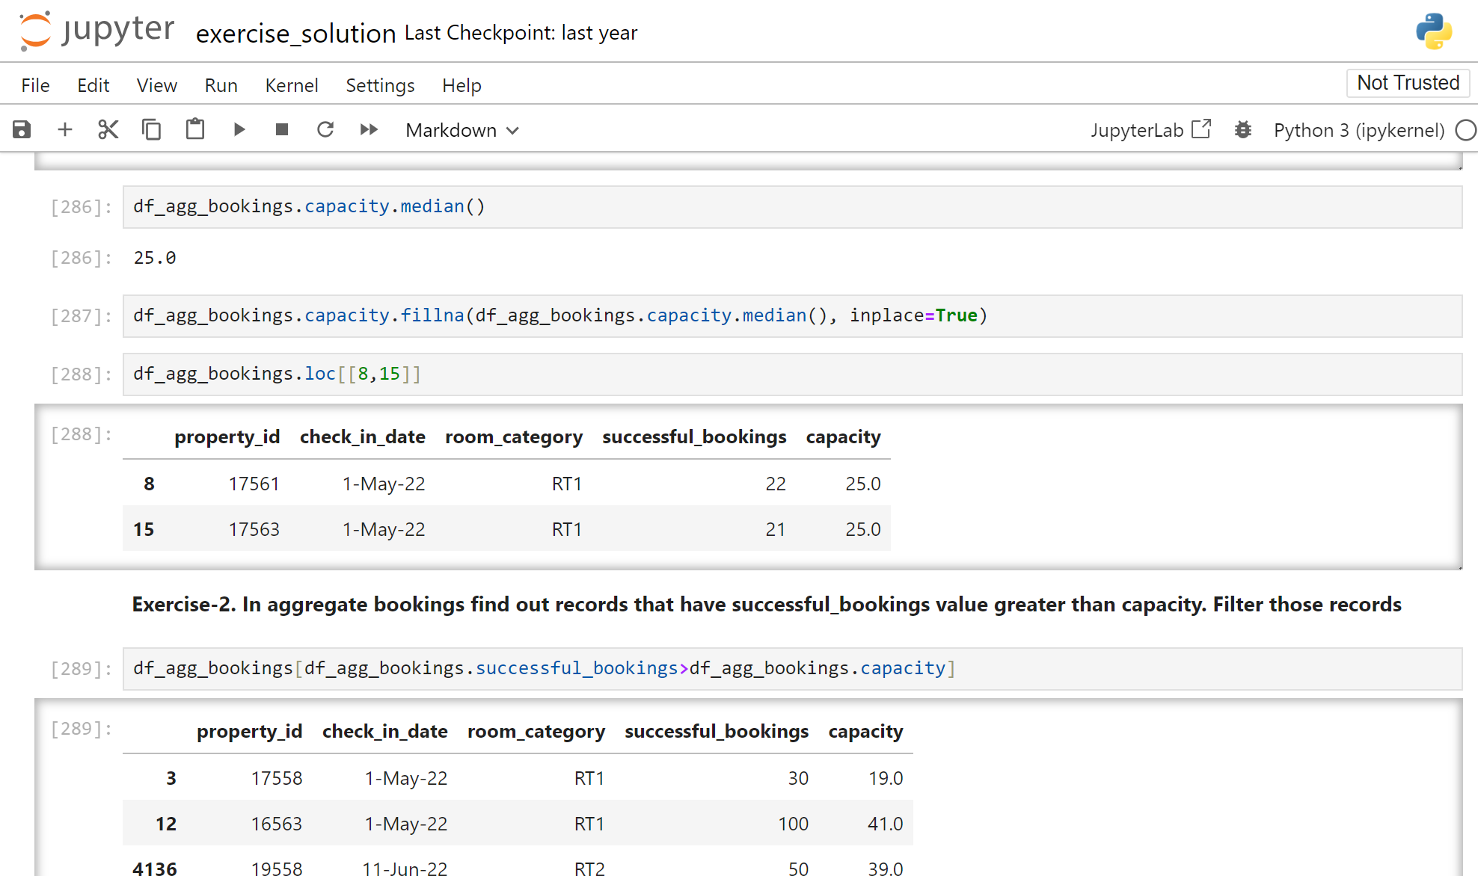
We addressed the null value in the capacity column of the df_agg_booking table by using the median function.

Slide 16
Timeline
Problem statement
About the dataset
Data cleaning
Data transformation
Analysis Insights
Briefly elaborate on what you want
to discuss.
Briefly elaborate on what you want
to discuss.
Briefly elaborate on what you want
to discuss.
Briefly elaborate on what you want
to discuss.
Briefly elaborate on what you want
to discuss.

Slide 17
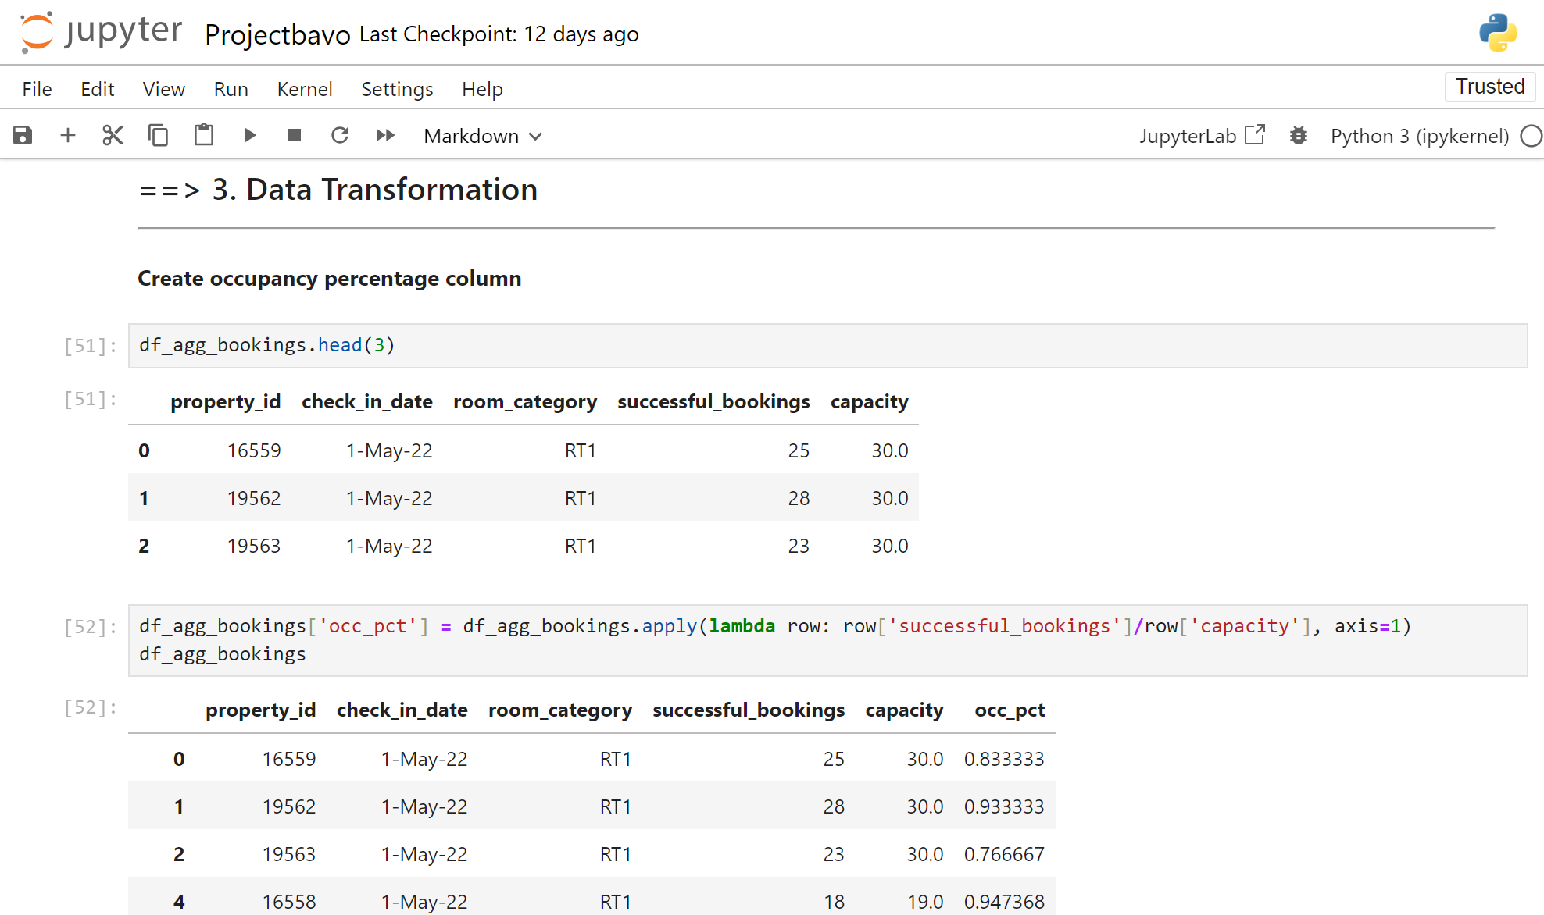
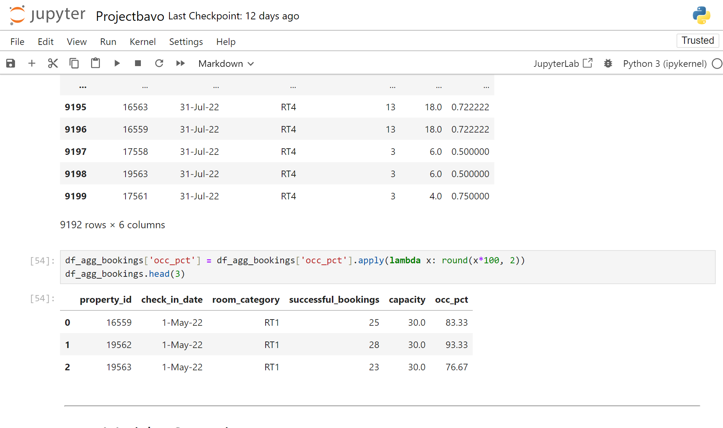
Data Transformation
It means transforming or changing data to such a state on which we can perform data analytics better.
(1) Create occupancy percentage column
Converted it into a percentage

Slide 18
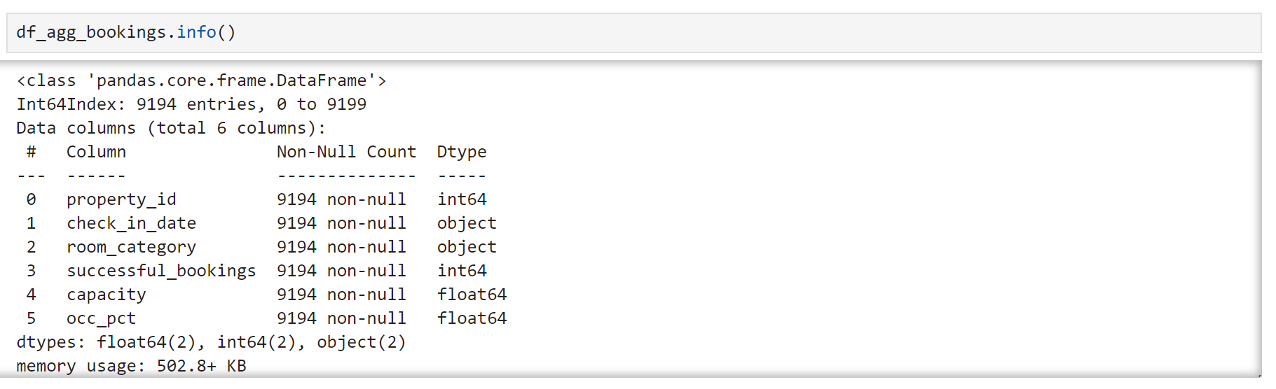
Data Transformation
(2) Cast dates to date time format
There are various types of data transformations that you may have to perform
based on the need. Few examples of data transformations are,
1.Creating new columns
2.Normalization
3.Merging data-using merge function
4.Aggregation-sum,mean,etc

Slide 19
Timeline
Problem statement
About the dataset
Data cleaning
Data transformation
Analysis Insights
Briefly elaborate on what you want
to discuss.
Briefly elaborate on what you want
to discuss.
Briefly elaborate on what you want
to discuss.
Briefly elaborate on what you want
to discuss.
Briefly elaborate on what you want
to discuss.

Slide 20
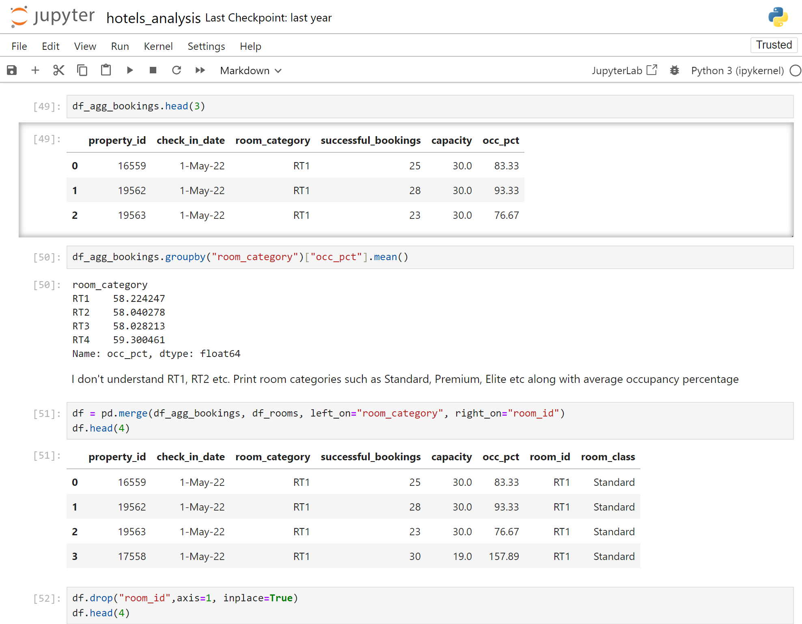
Analysis Insights
(1) What is an average occupancy rate in each of the room categories?
I don't understand RT1, RT2, etc., so I need to print room categories such as Standard, Premium, Elite, etc., along with the average occupancy percentage for better understanding.

Slide 21
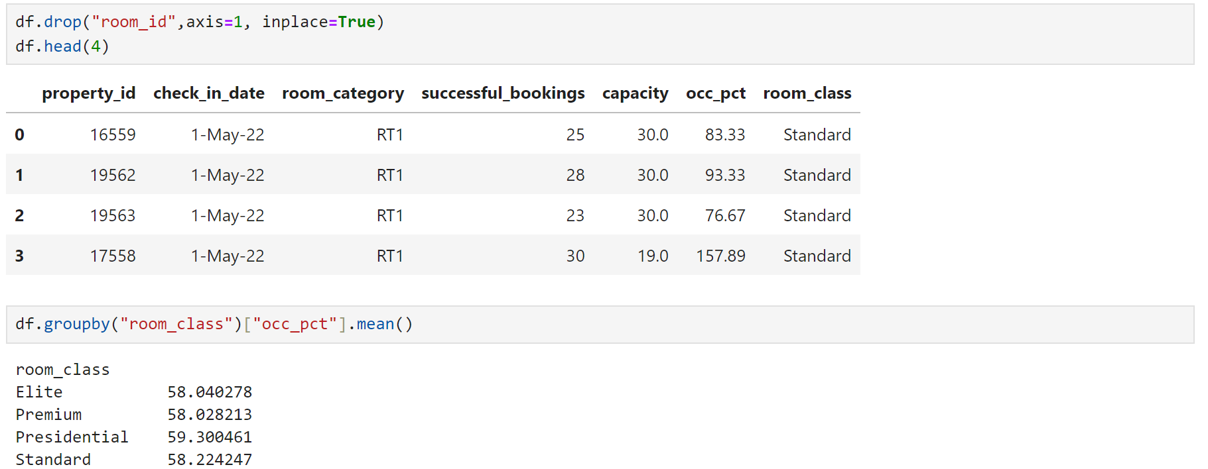
Analysis Insights

Slide 22
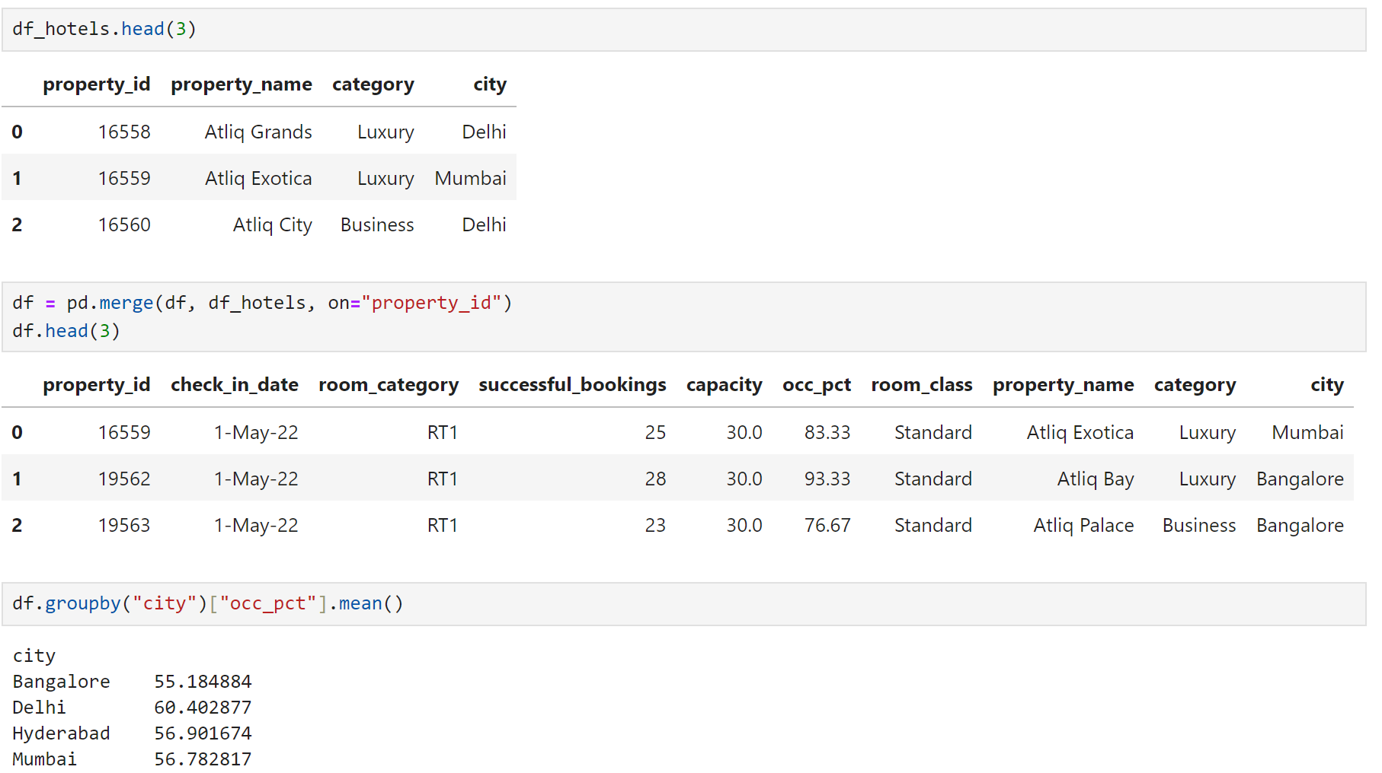
Analysis Insights
(2) Print average occupancy rate per city

Slide 23
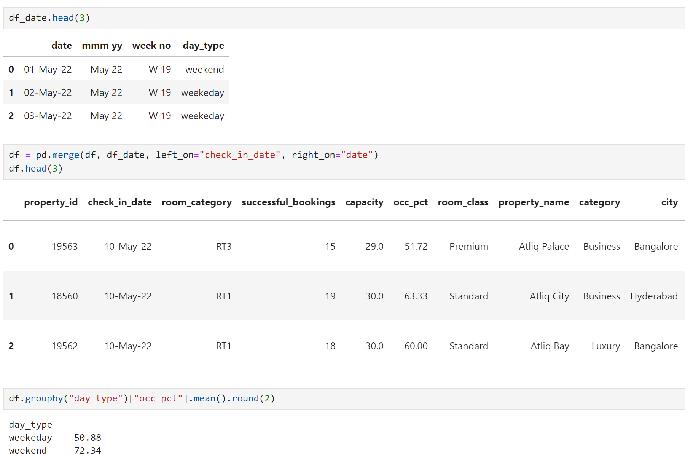
Analysis Insights
(3) When was the occupancy better? Weekday or Weekend?

Slide 24
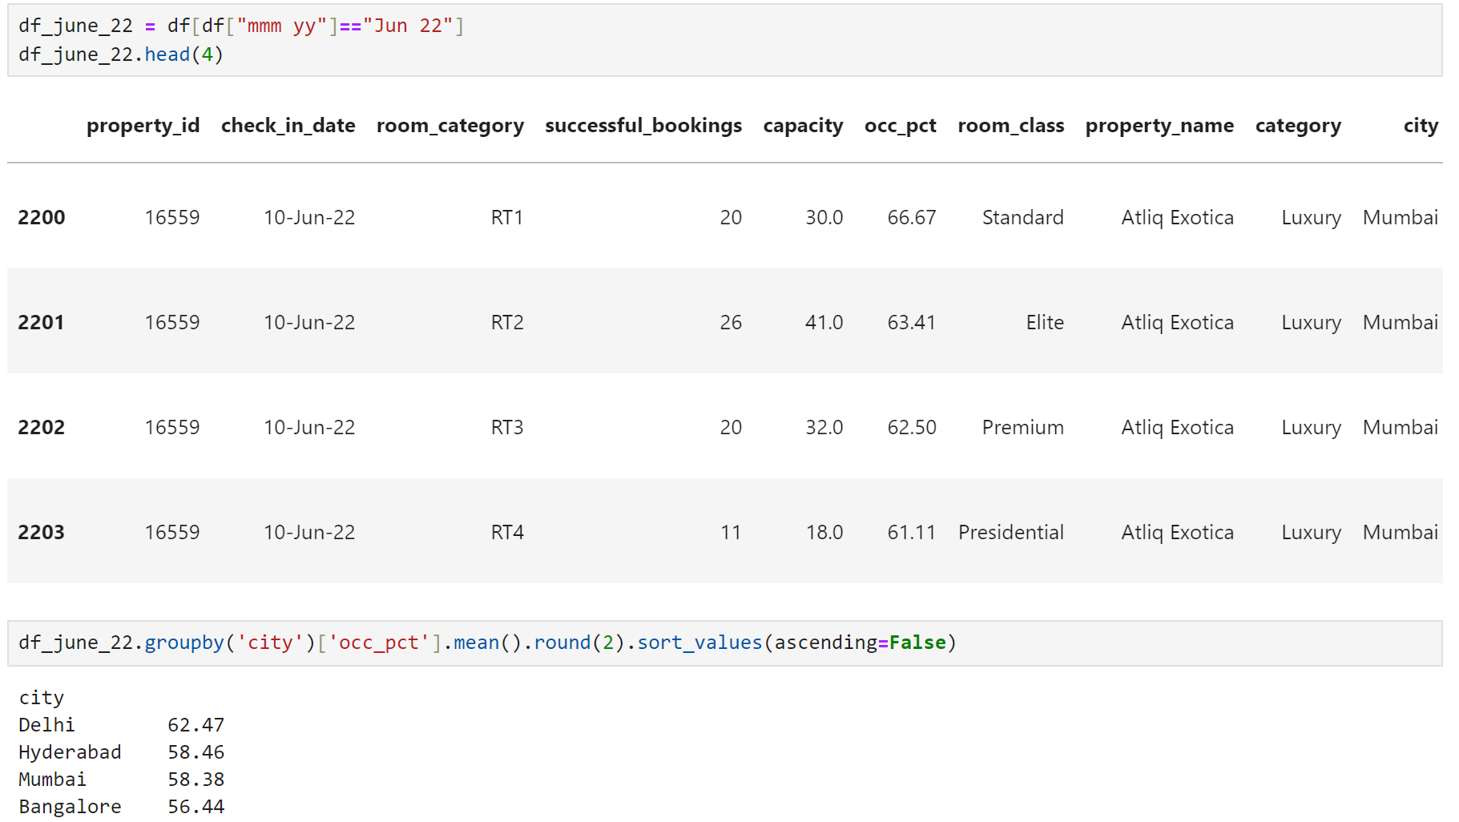
Analysis Insights
(4) In the month of June, what is the occupancy for different cities

Slide 25
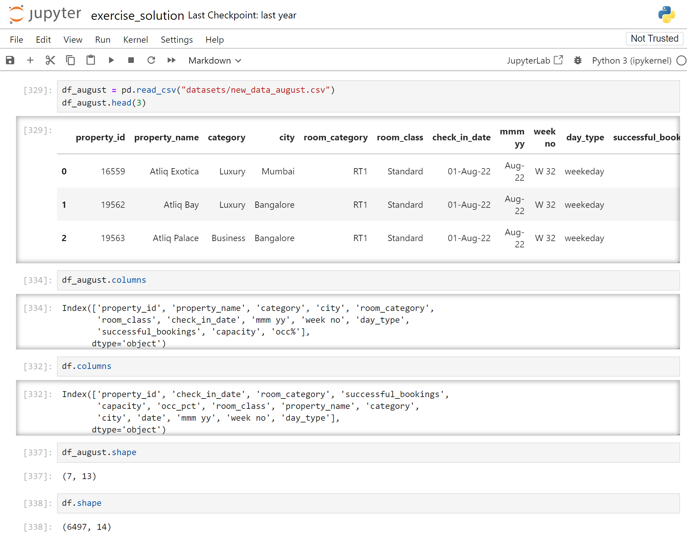
Analysis Insights
(5) We got new data for the month of august. Append that to existing data

Slide 26
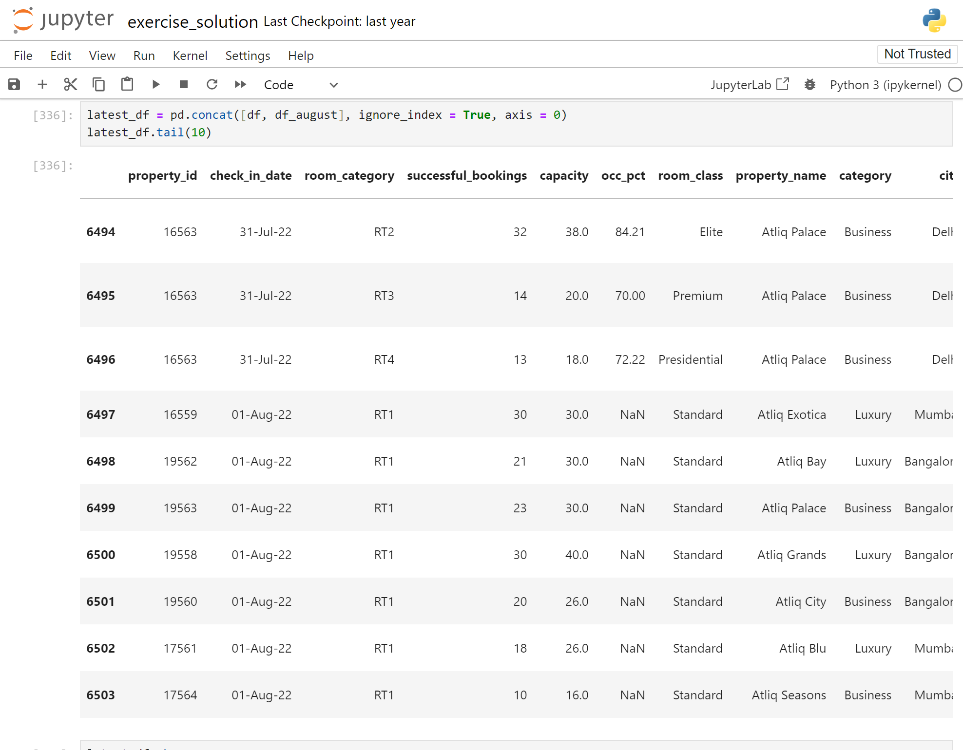
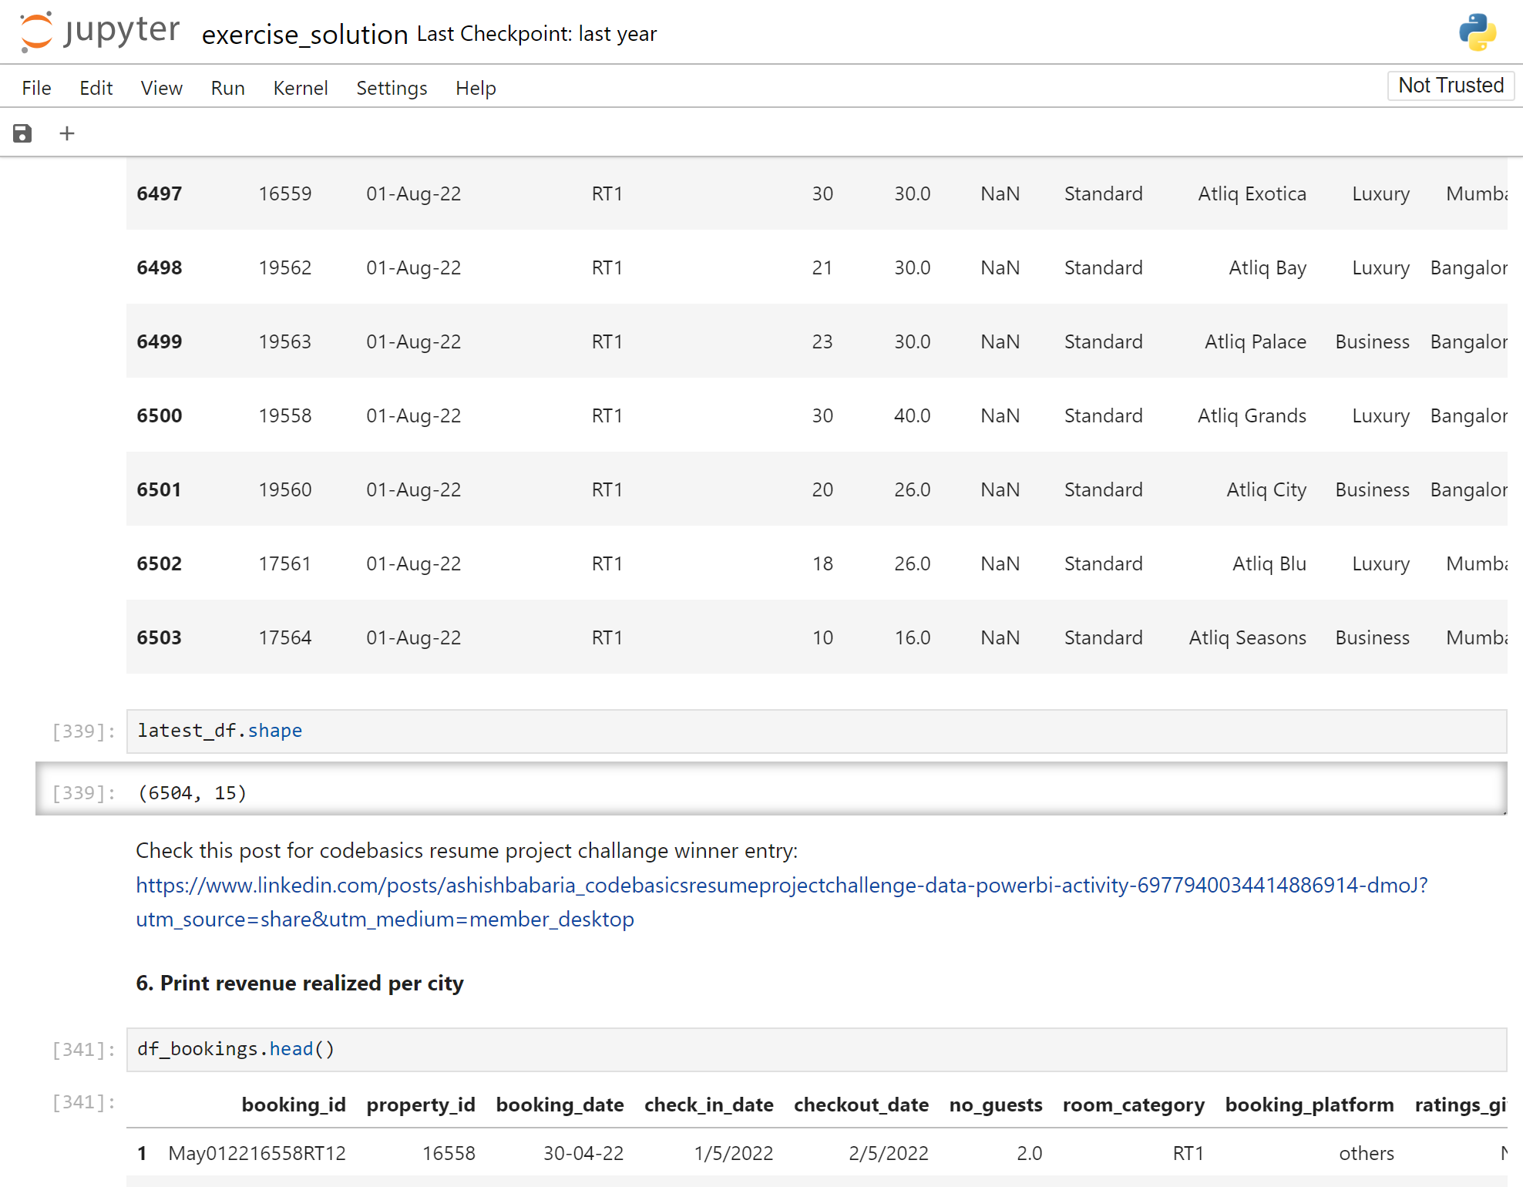
Analysis Insights
Before appending the dataframe, we had 6497 columns and 14 rows. After the append operation, we ended up with 6504 columns and 15 rows. From this, we can confidently conclude that the new table was successfully appended.

Slide 27
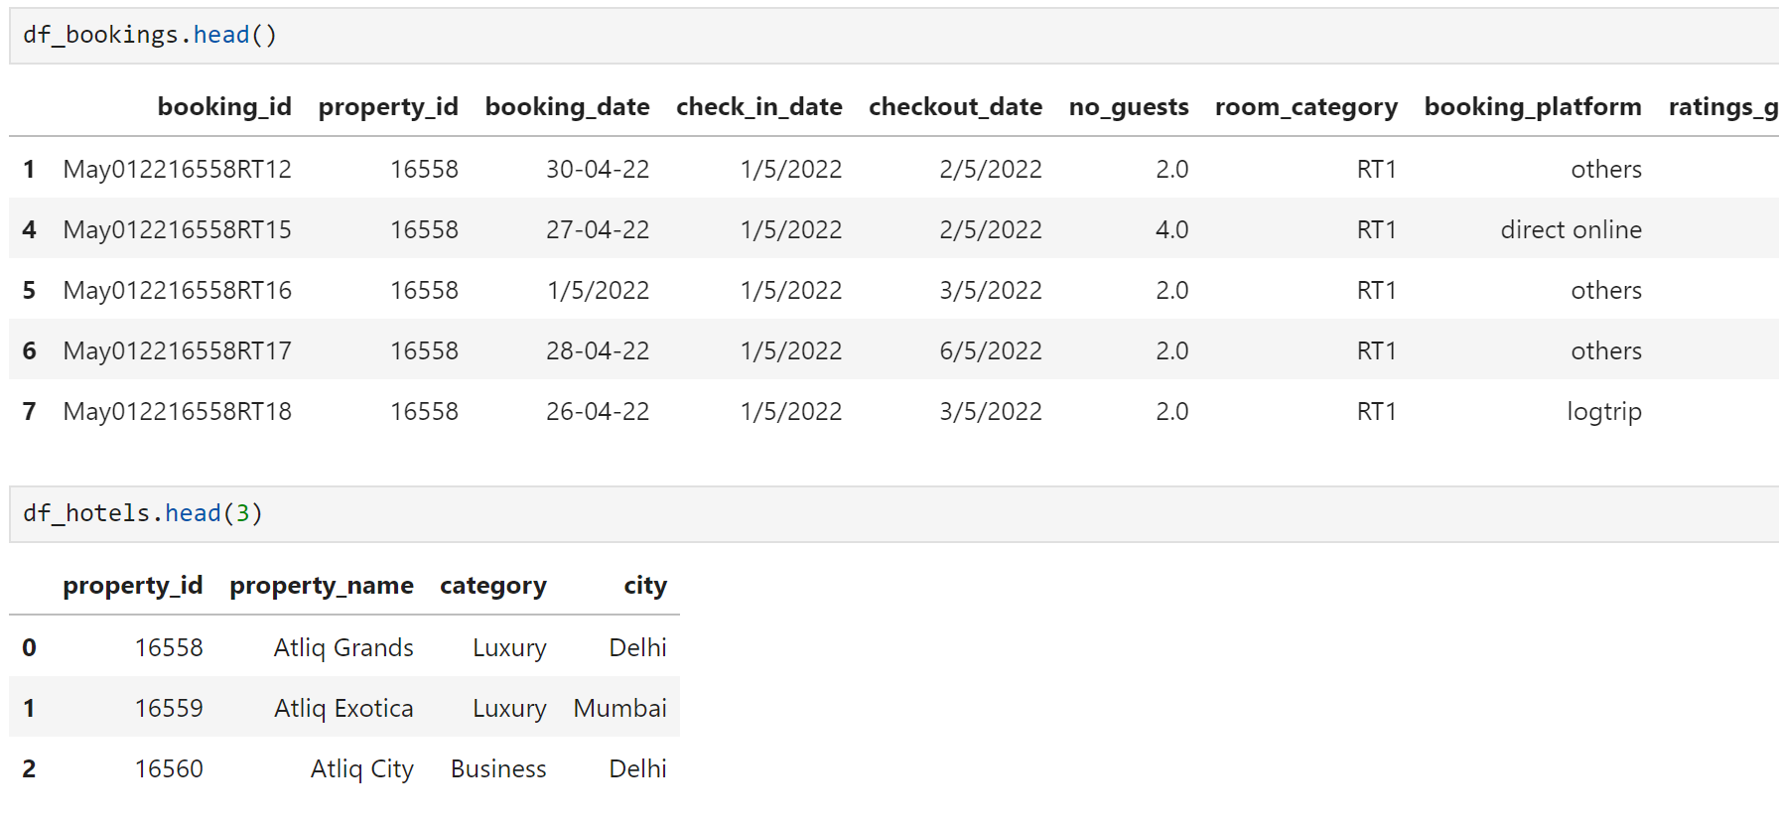
Analysis Insights
(6) Print revenue realized per city
So, we need to calculate the revenue realized per city using the bookings data. The city data is located in a different table, so we need to merge these two tables to proceed with the analysis of the revenue realized per city.

Slide 28
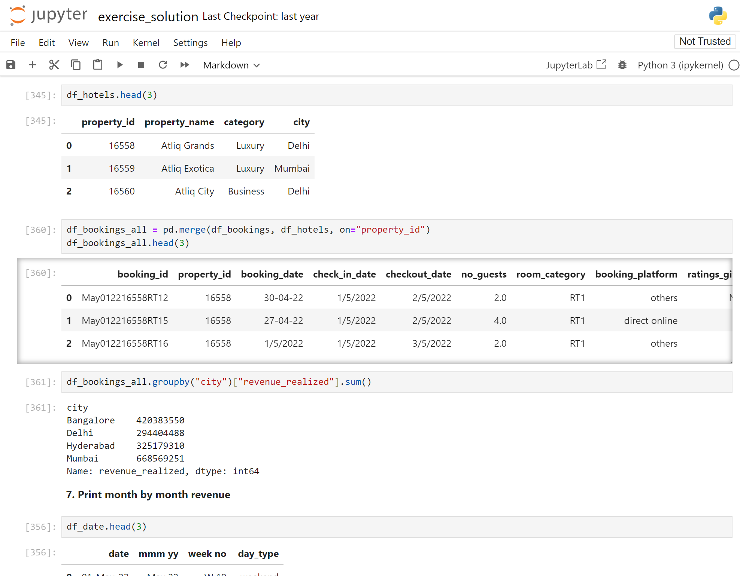
Analysis Insights
After merging the two tables, we grouped them by city and realized revenue, then calculated the sum to find the revenue realized per city.

Slide 29
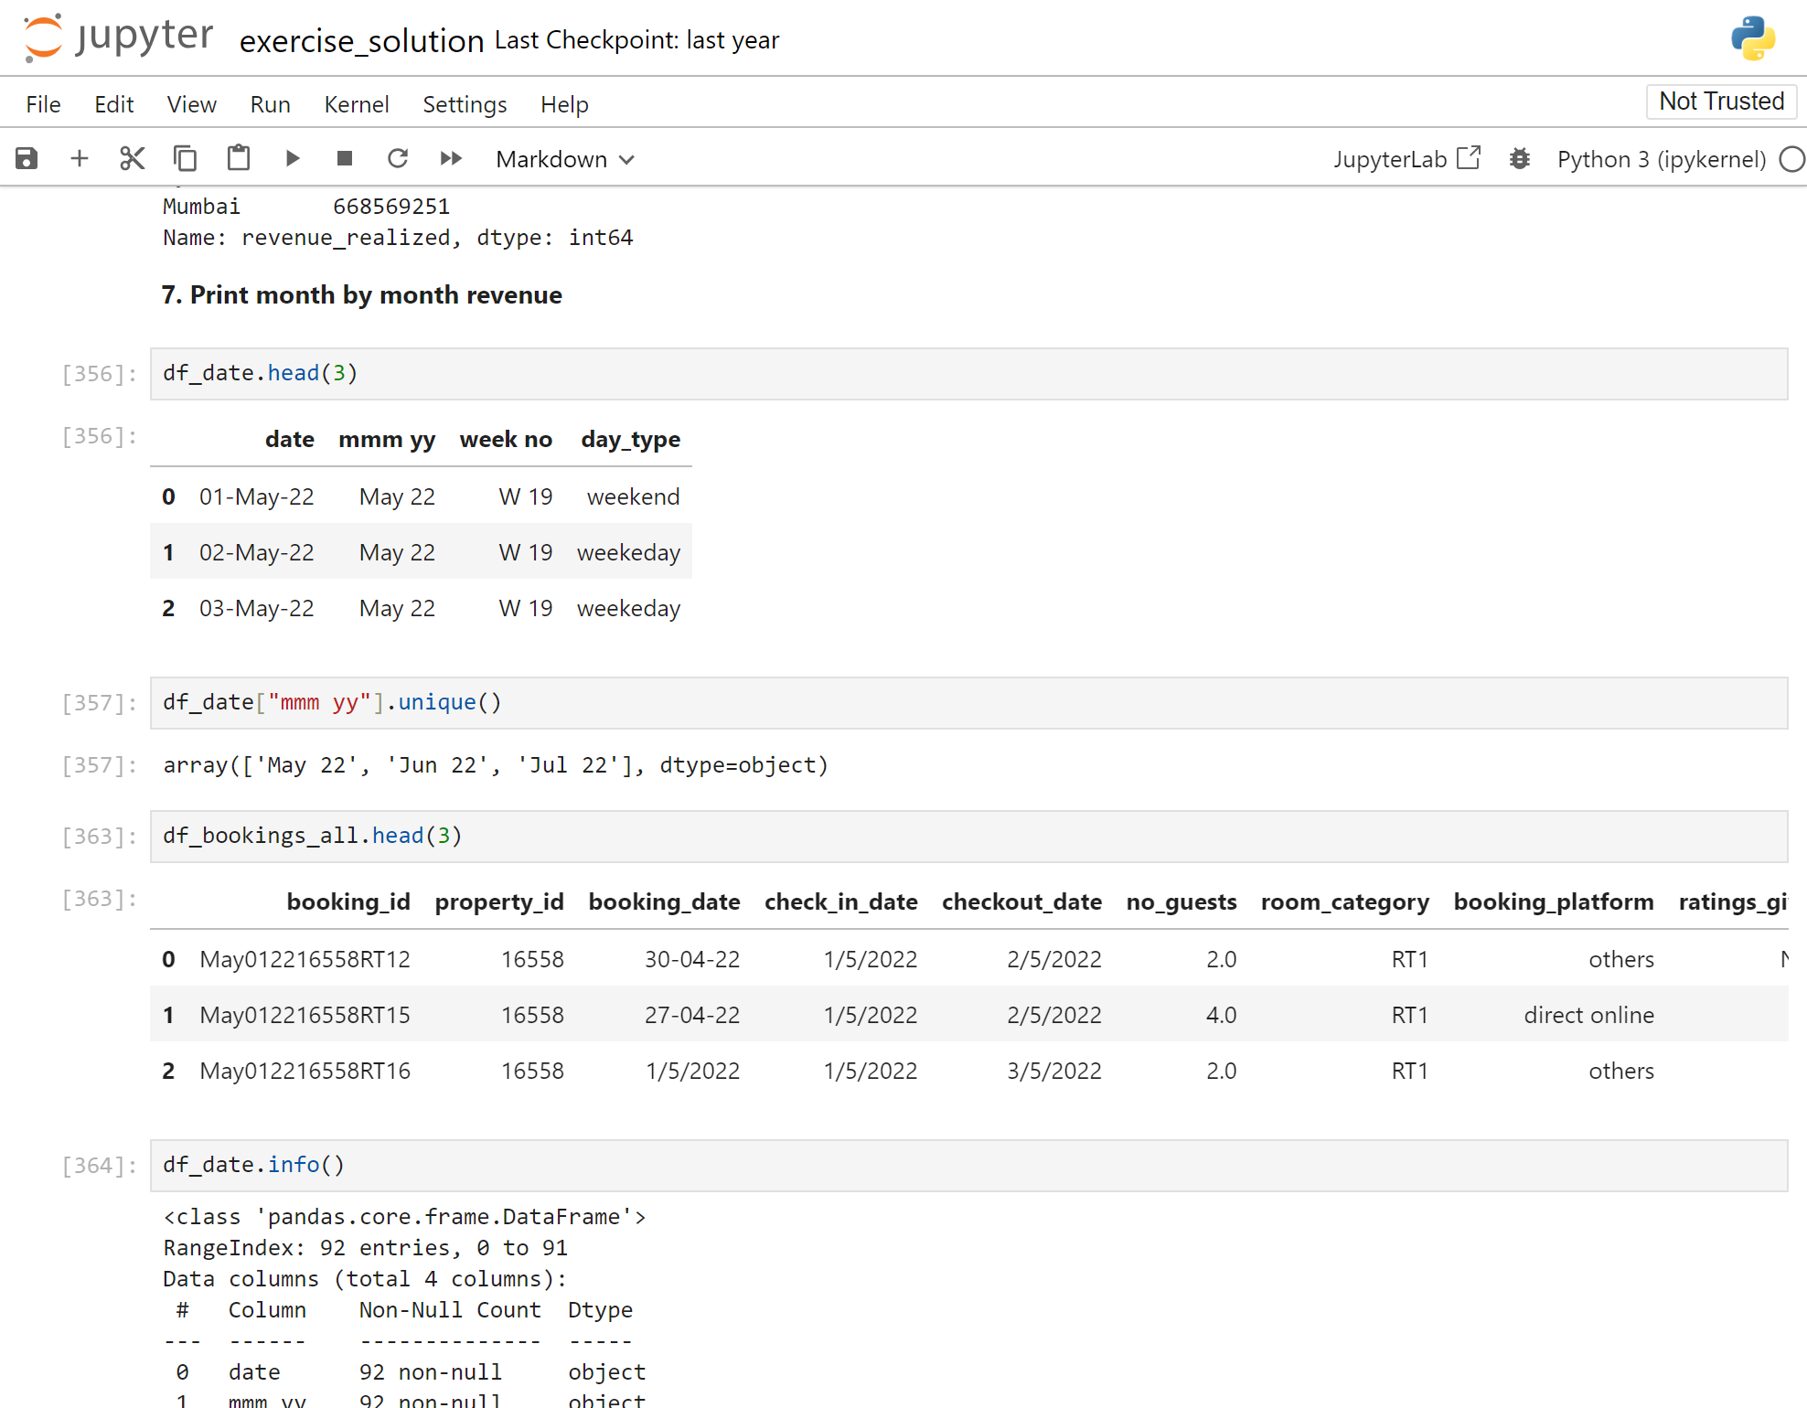
Analysis Insights
(7) Print month by month revenue
After printing the date dataframe, I identified that there are 3 months of revenue data. I will be working on analyzing it further.

Slide 30
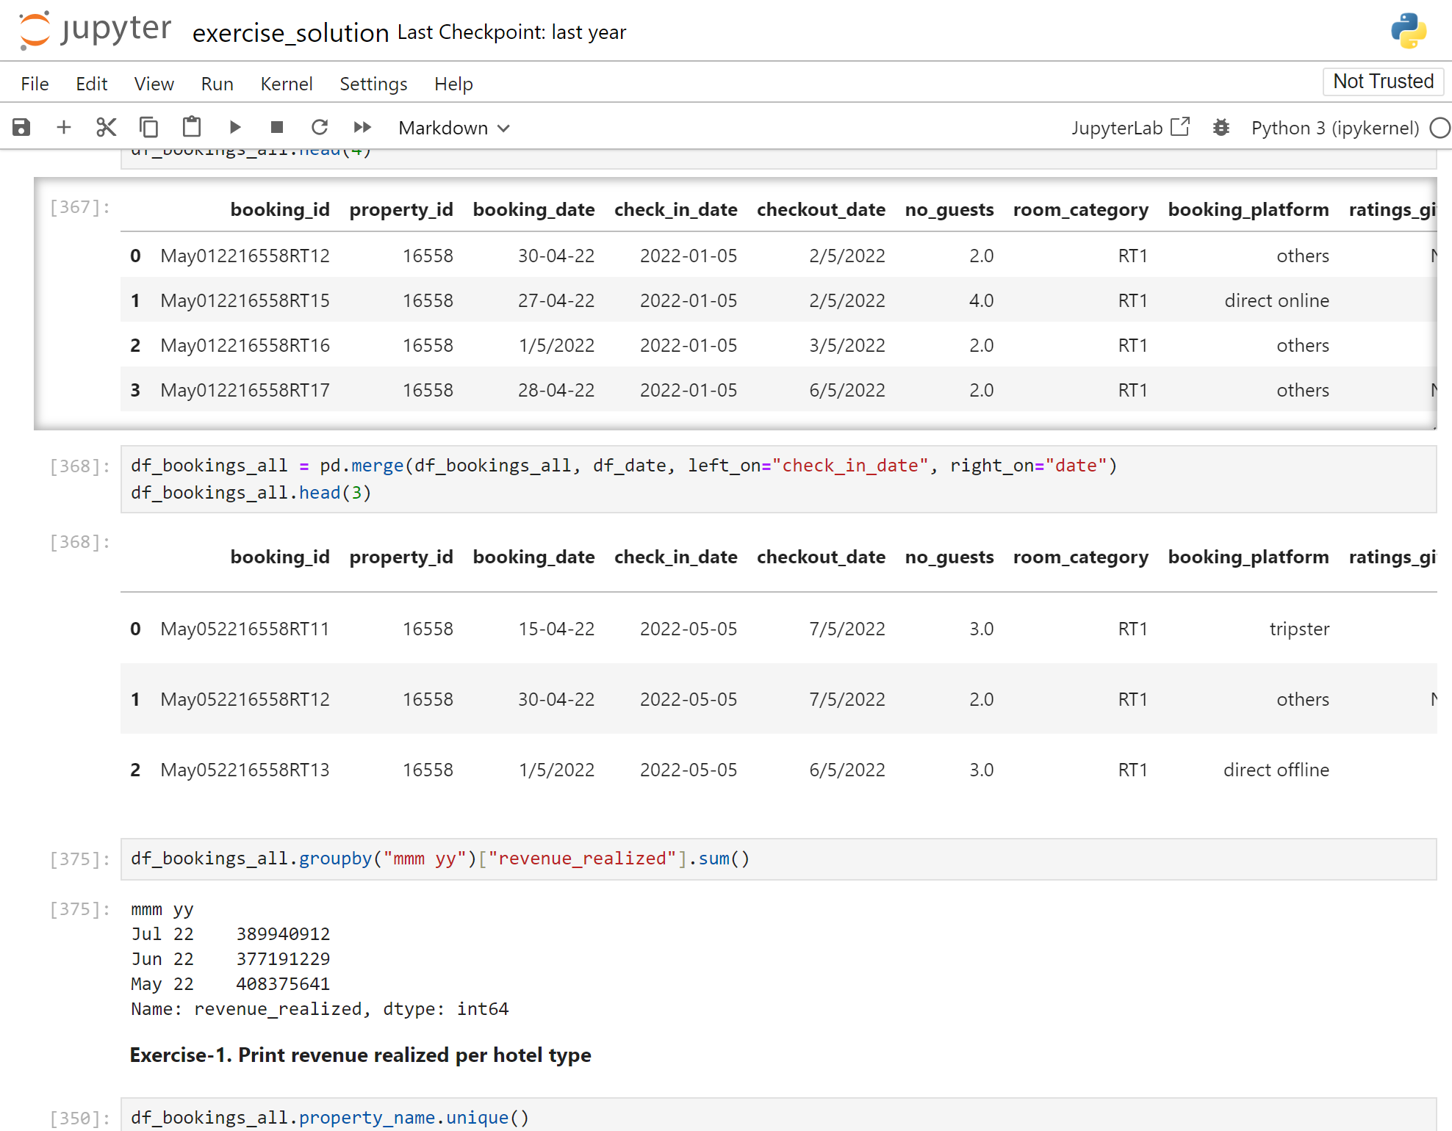
Analysis Insights
In the "df_booking" dataframe table, we have all the transaction data. To find the revenue realized per month, we must merge the two tables to calculate it.
After merging, we group by date and revenue realized to calculate revenue realized by month.

Slide 31
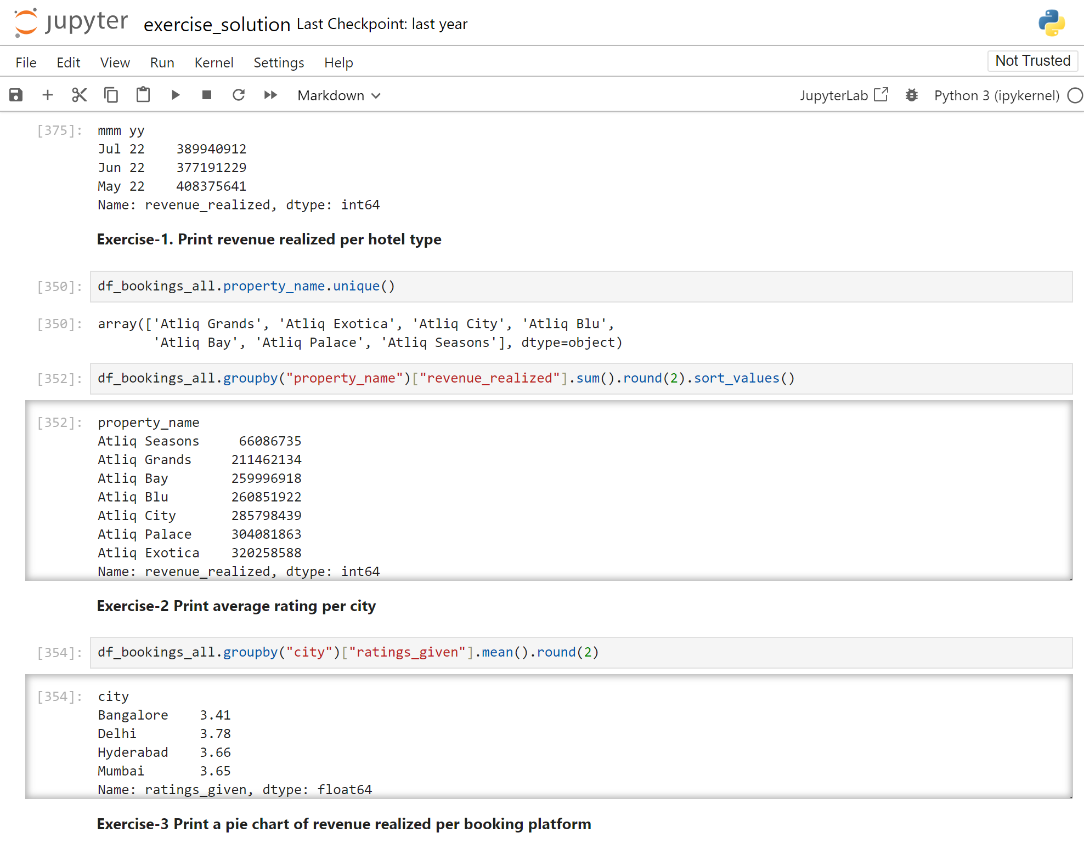
Analysis Insights
(8) Print revenue realized per hotel type
(9) Print average rating per city

Slide 32
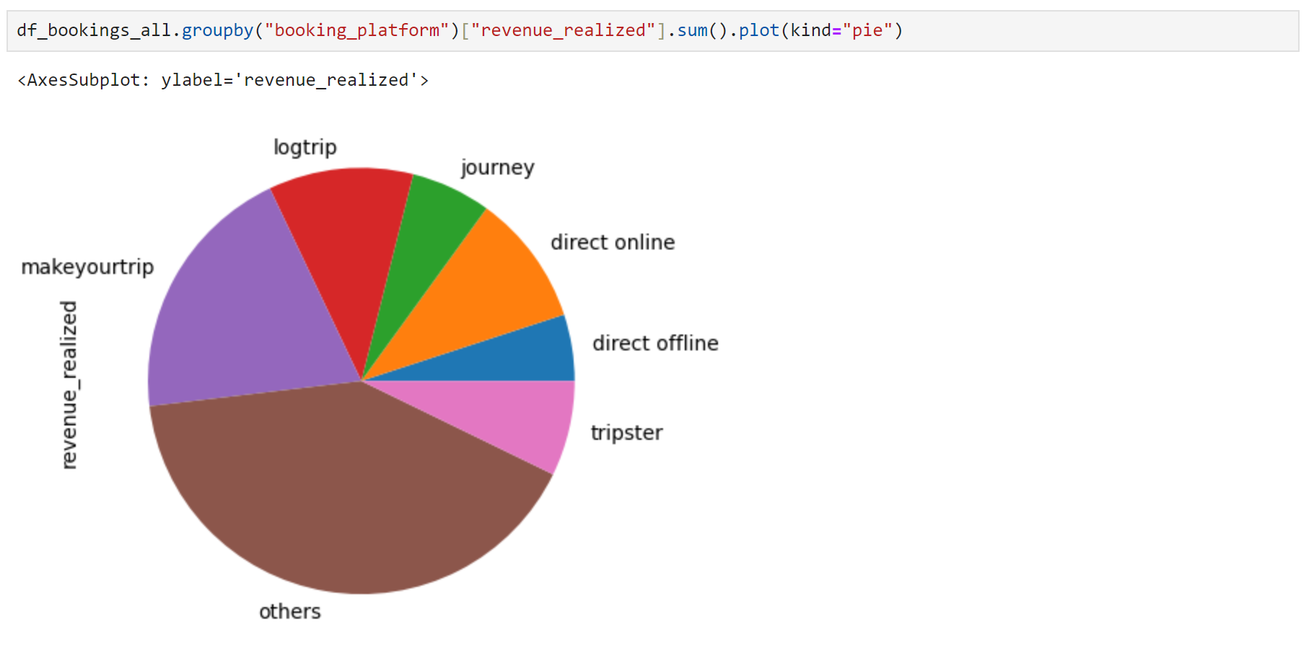
Analysis Insights
(10) Print a pie chart of revenue realized per booking platform

Slide 33

INSIGHTS
Revenue Insights:
Top Earning City: | Mumbai led in revenue with 669M INR, while Delhi lagged at 291M INR.
Best Month : | May generated the highest revenue (581.93M INR), while June was the lowest (553.93M INR)
Popular Room Category: | Elite rooms brought in the most revenue, hitting 553.74M INR.
Customer Experience Highlights:
Highest-Rated Room: | Guests loved the Presidential rooms the most, rating them at 3.69. Premium rooms got the lowest rating at 3.59
City with Best Ratings: | Delhi stood out with an average rating of 3.78, showing guests had a great experience.
Revenue Insights:
Occupancy Leader: | Delhi not only excelled in ratings but also had the highest occupancy at 62.47%.
Weekend Rush: | Weekends, especially Fridays and Saturdays, saw more bookings, hinting at an opportunity for targeted promotions

Slide 34
Recommendations
Mumbai Momentum: | Invest in marketing for Mumbai to further boost revenue.
Premium Upgrade: | Enhance the Premium room experience for better ratings and potentially higher revenue.
Optimize Delhi Stays: | Despite high ratings, find ways to fill more rooms in Delhi for increased revenue.
Weekend Promotions: | Leverage the weekend demand with targeted marketing on Fridays and Saturdays.
Stay Adaptive: | Keep an eye on feedback, ratings, and trends for continuous improvement and competitiveness.

Slide 35


Thank You
Grateful for your time is discovering the transformative power of data in hospitality

